Slide 1

On a Novel Superconducting On-Chip Fourier Transform Spectrometer
Emily Linden
Mentors: Phil Mauskopf, Farzad Faramarzi, Sasha Sypkens
Arizona State University Department of Physics and School of Earth and Space Exploration

Slide 2
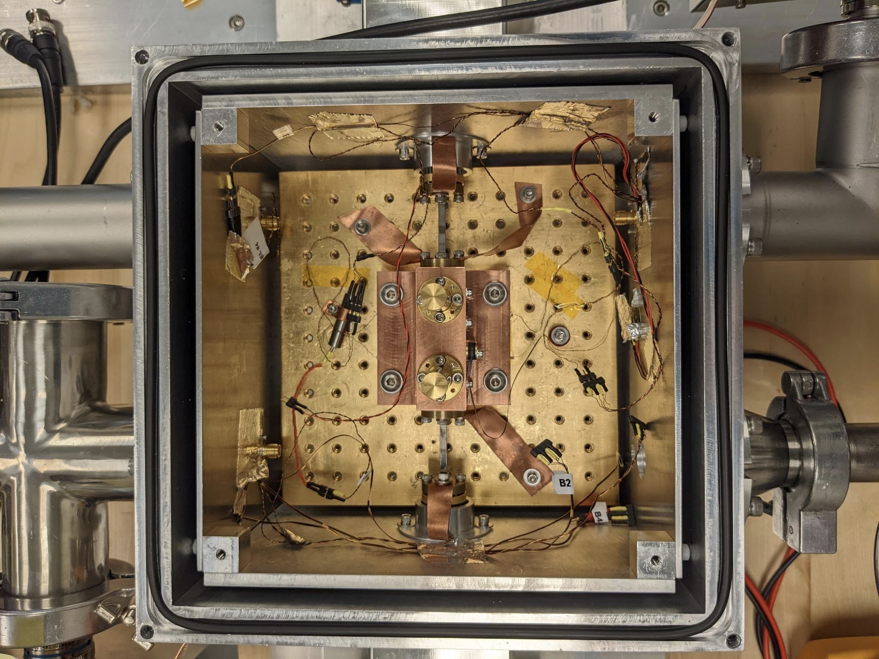
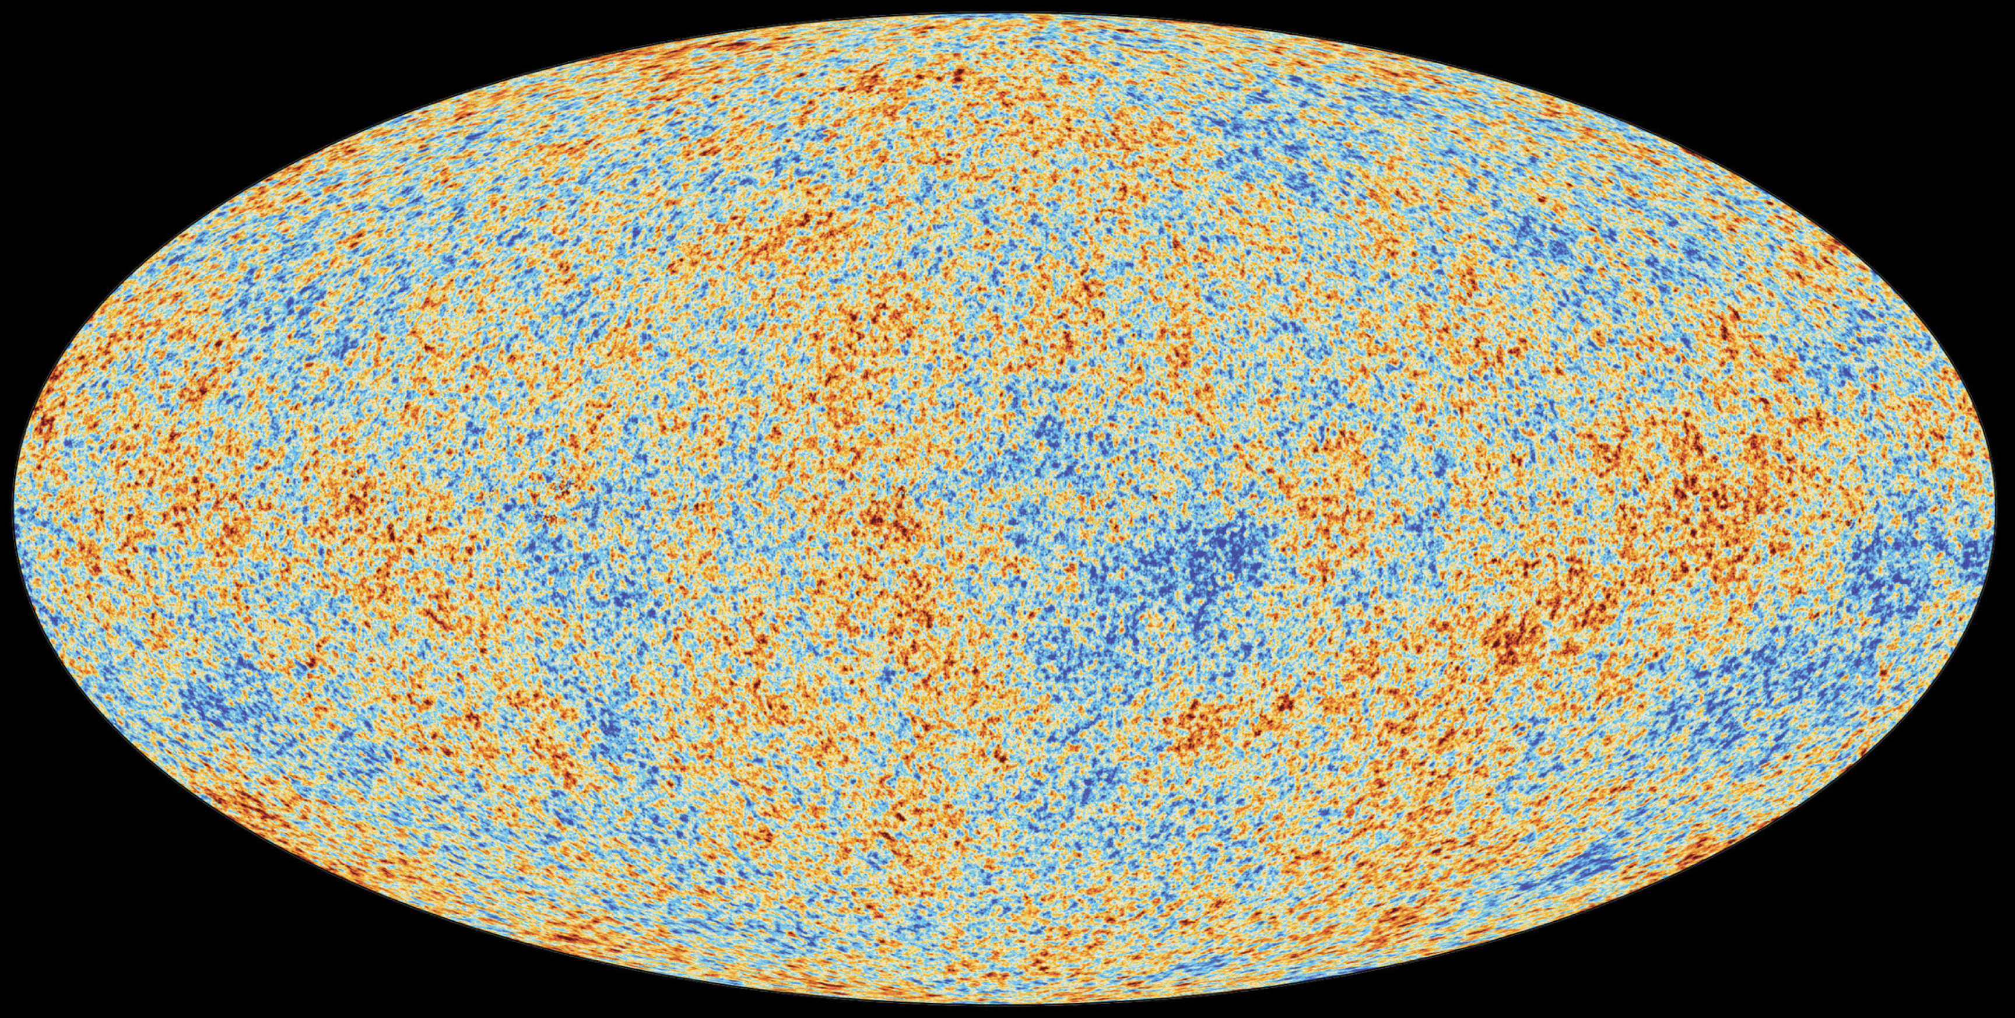
SOFTS is an efficient way for obtaining spectral content for millimeter-wave astronomy and observational cosmology surveys
The Cosmic Microwave Background (CMB) can be measured using SOFTS.
SOFTS device in a cryostat that cools to 3.1 K.

Slide 3
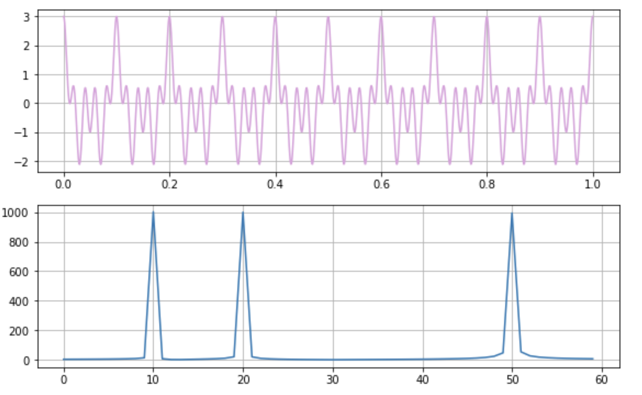
Background
Kinetic Inductance
Kinetic inductance is a property of the superconducting material that can be affected by applying DC current.
Fourier Transform
A Fourier Transform is the process of converting measurements from the time domain to the frequency domain. Measurements of light in the time domain can have overlapping frequencies, but decomposition of light into these different frequencies can be done using an FTS.
signal in time domain
frequencies of components

Slide 4
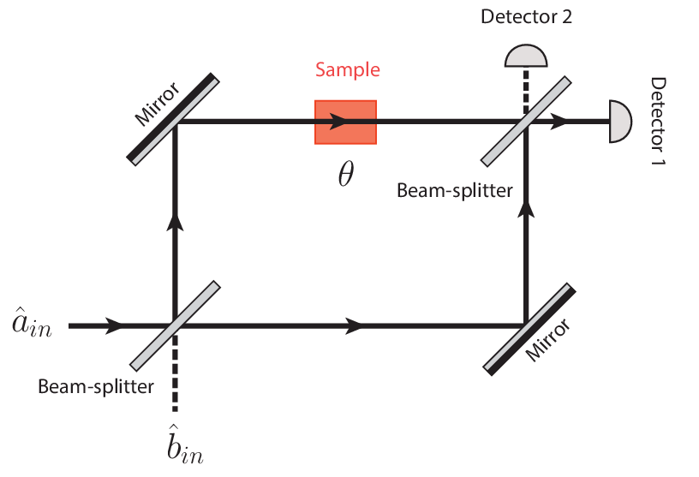
Background
Mach-Zehnder Interferometer
conventional meter-scale spectrometers
based on opto-mechanical technology

Slide 5
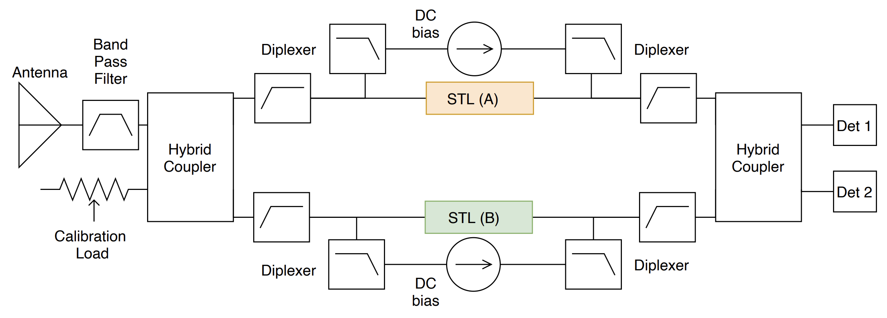
Design
Quadrature hybrids
STLs
Thin film superconducting transmission lines (STLs) have non-linear current dependent kinetic inductance, which can be exploited to introduce a path length difference in one of the STLs
4-port SOFTS diagram (taken with permission)

Slide 6
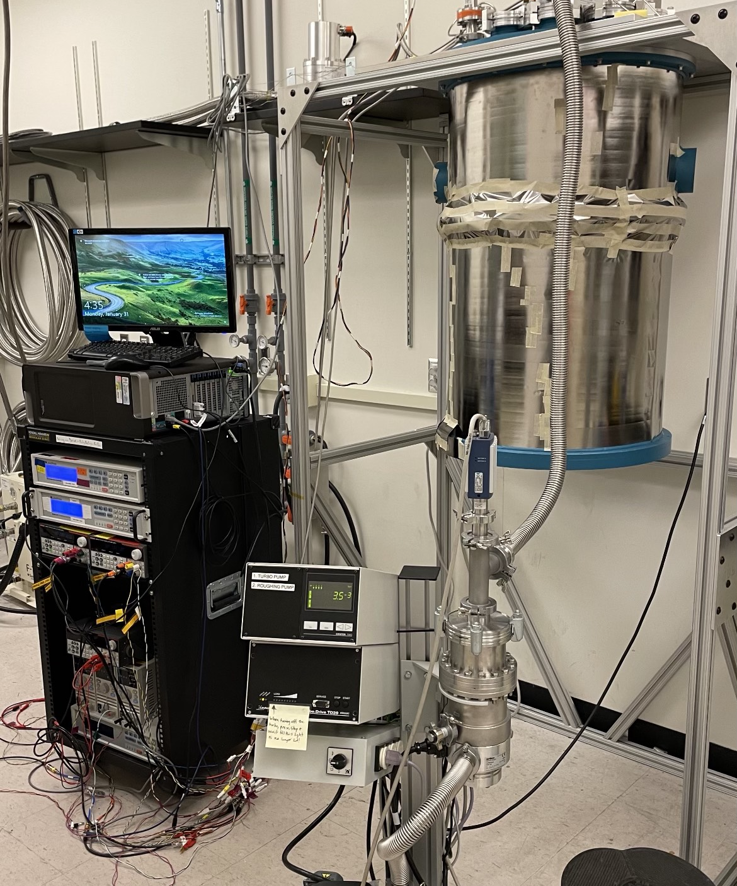
Design
calculations and simulations show that spectroscopy can be conducted with SOFTS on a millimeter scale and achieve similar or better results than the conventional meter-scale spectrometers
This design allows for the FTS to be on a compact cm-scale wafer, which can be carried on balloon missions or even satellites.
Cryostat that cools to 250 mK; to be used for the SOFTS measurements.

Slide 7
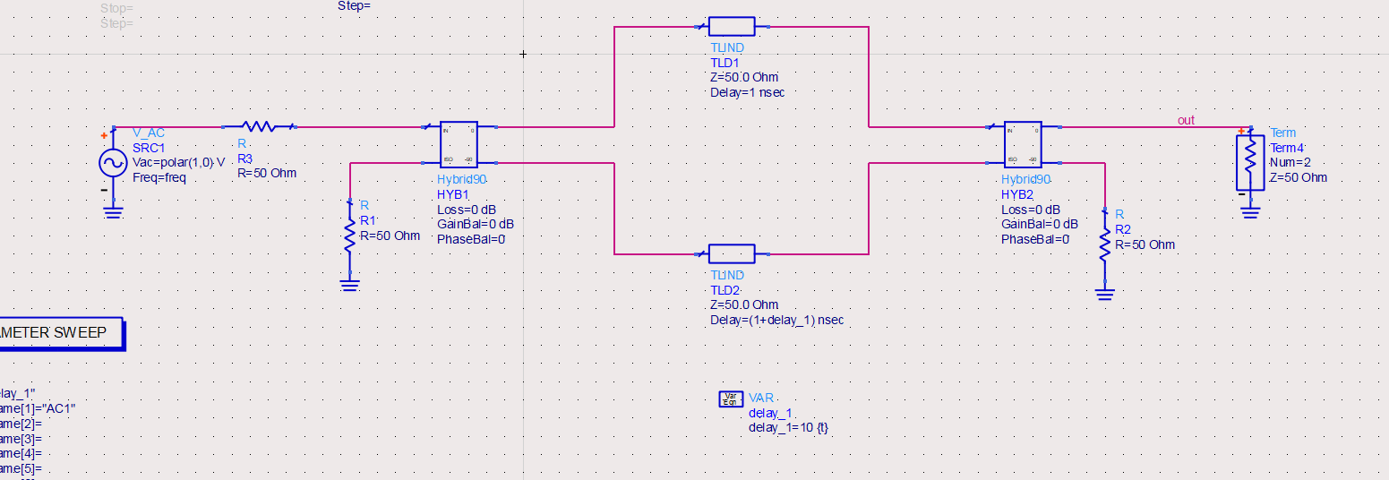
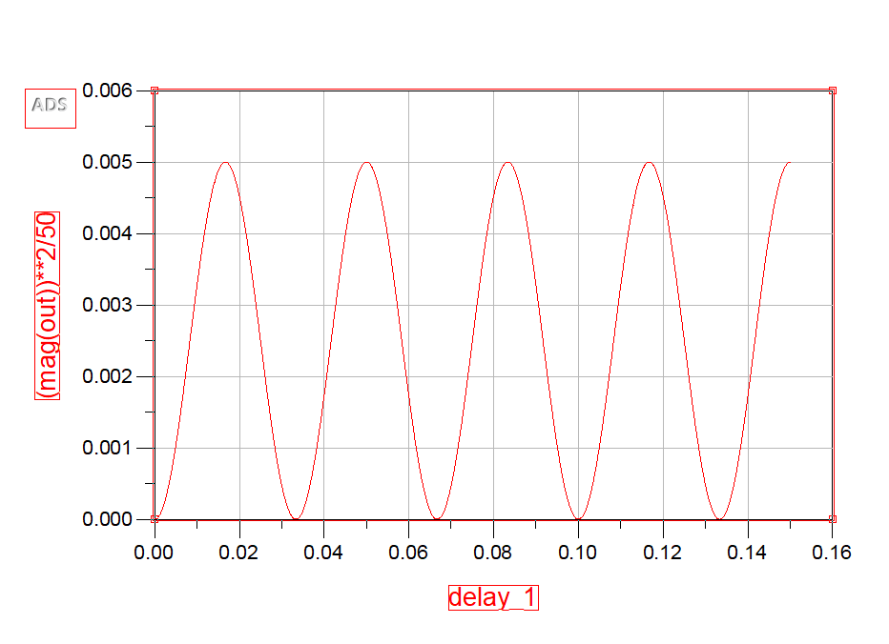
Simulation
SOFTS simulation using ADS
SOFTS simulation output

Slide 8
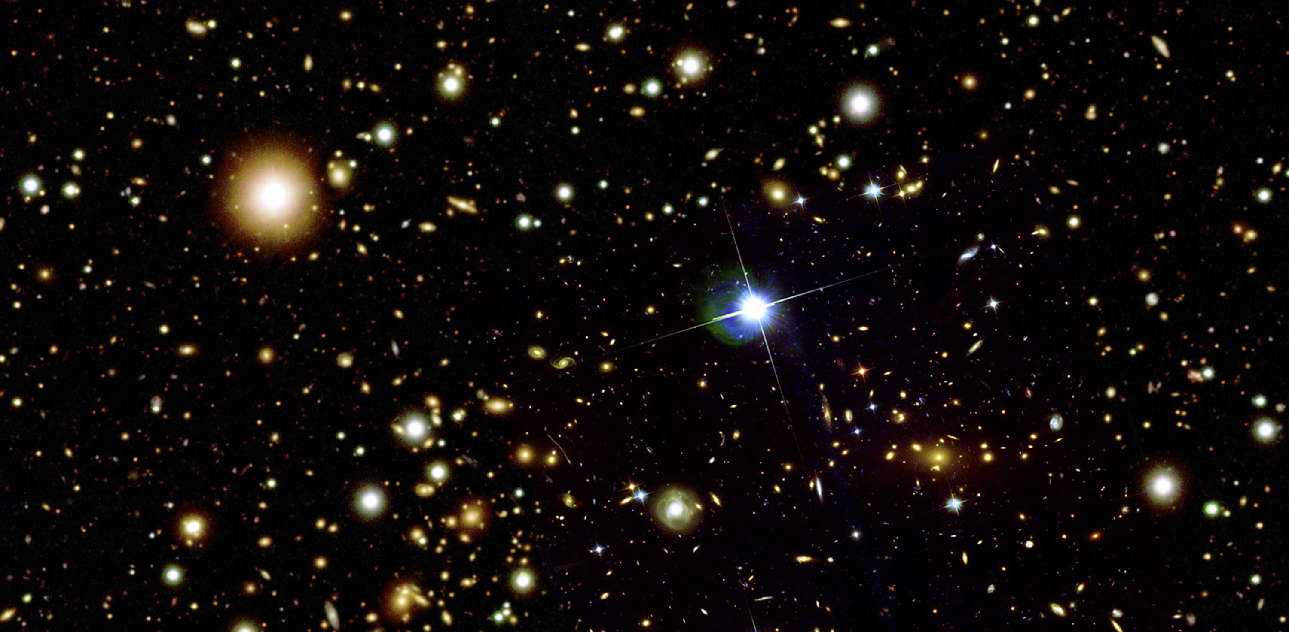
Applications
The Cosmic Microwave Background (CMB) can be measured using SOFTS.
The Galaxy Cluster 1E 0657-56. Galaxy clusters can be studied using SOFTS.

Slide 9
Acknowledgements
NASA Space Grant
Phil Mauskopf
Farzad Faramarzi and Sasha Sypkens
Collaborators at JPL and Caltech

Slide 10
Thank you!

